Slide 1
Foundations of Machine Learning
Module 4:
Part B: Bayesian Learning
Sudeshna Sarkar
IIT Kharagpur

Slide 2
Probability for Learning
Probability for classification and modeling concepts.
Bayesian probability
Notion of probability interpreted as partial belief
Bayesian Estimation
Calculate the validity of a proposition
Based on prior estimate of its probability
and New relevant evidence

Slide 3
Bayes Theorem
Goal: To determine the most probable hypothesis, given the data D plus any initial knowledge about the prior probabilities of the various hypotheses in H.

Slide 4
Bayes Theorem
Bayes Rule:
P(h) = prior probability of hypothesis h
P(D) = prior probability of training data D
P(h|D) = probability of h given D (posterior density )
P(D|h) = probability of D given h (likelihood of D given h)

Slide 5
An Example
Does patient have cancer or not?
A patient takes a lab test and the result comes back positive. The test returns a correct positive result in only 98% of the cases in which the disease is actually present, and a correct negative result in only 97% of the cases in which the disease is not present. Furthermore, .008 of the entire population have this cancer.

Slide 6
Maximum A Posteriori (MAP) Hypothesis
The Goal of Bayesian Learning: the most probable hypothesis given the training data (Maximum A Posteriori hypothesis)

Slide 7
Maximum Likelihood (ML) Hypothesis
If every hypothesis in H is equally probable a priori, we only need to consider the likelihood of the data D given h, P(D|h). Then, h_{MAP} becomes the Maximum Likelihood,
h_{ML}= argmax _{h∈H} P(D|h)

Slide 8
MAP Learner
For each hypothesis h in H, calculate the posterior probability
Output the hypothesis hMAP with the highest posterior probability
Comments:
Computational intensive
Providing a standard for judging the performance of learning algorithms
Choosing P(h) and P(D|h) reflects our prior knowledge about the learning task

Slide 9
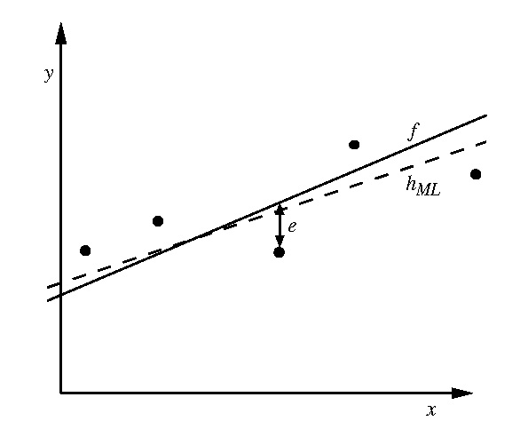
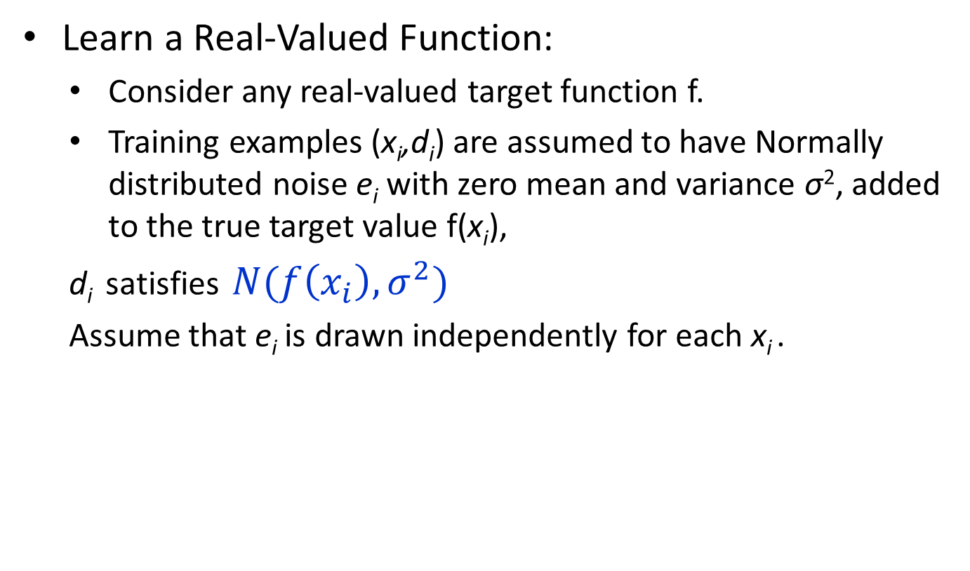
Maximum likelihood and least-squared error
Learn a Real-Valued Function:
Consider any real-valued target function f.
Training examples (x_{i},d_{i}) are assumed to have Normally distributed noise e_{i} with zero mean and variance σ², added to the true target value f(x_{i}),
d_{i} satisfies $N(f\left(x_{i}\right), σ^{2})$
Assume that e_{i} is drawn independently for each x_{i} .

Slide 10
Compute ML Hypo
Notes:
Assume noise in output, not in attribute!

Slide 11
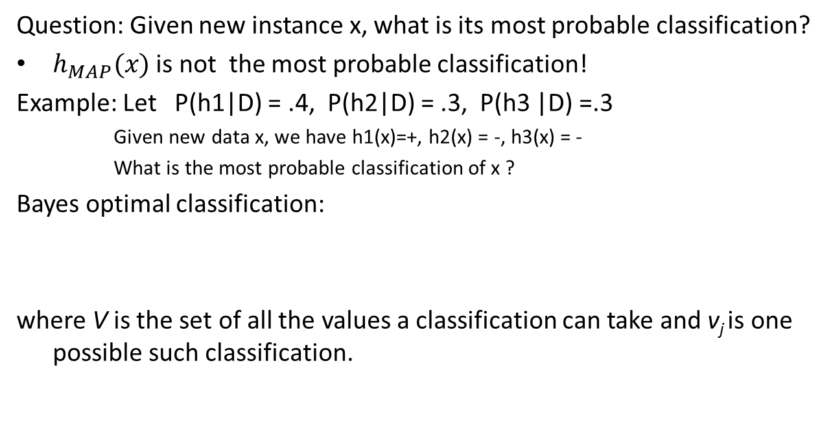
Bayes Optimal Classifier
Question: Given new instance x, what is its most probable classification?
$h_{MAP}(x)$ is not the most probable classification!
Example: Let P(h1|D) = .4, P(h2|D) = .3, P(h3 |D) =.3
Given new data x, we have h1(x)=+, h2(x) = -, h3(x) = -
What is the most probable classification of x ?
Bayes optimal classification:
where V is the set of all the values a classification can take and v_{j} is one possible such classification.
Example:
P(h1| D) =.4, P(-|h1)=0, P(+|h1)=1
P(h2|D) =.3, P(-|h2)=1, P(+|h2)=0
P(h3|D)=.3, P(-|h3)=1, P(+|h3)=0

Slide 12
Why “Optimal”?
Optimal in the sense that no other classifier using the same H and prior knowledge can outperform it on average

Slide 13
Gibbs Algorithm
Bayes optimal classifier is quite computationally expensive, if H contains a large number of hypotheses.
An alternative, less optimal classifier Gibbs algorithm, defined as follows:
Choose a hypothesis randomly according to P(h|D), where D is the posterior probability distribution over H.
Use it to classify new instance

Slide 14
Error for Gibbs Algorithm
Surprising fact: Assume the expected value is taken over target concepts drawn at random, according to the prior probability distribution assumed by the learner, then (Haussler et al. 1994)

Slide 15
Thank You

